Slide 1

SAP HANA Workshop
Kapitola 2: Technologie
Jakub Vajda, konzultant

Slide 2
In-memory koncepty
Architektura systému
Edice
Nasazení

Slide 3
In-memory koncepty
Architektura systému
Edice
Nasazení

Slide 4
SAP HANA – Technologie
Koncept – in-memory
1974 – IBM System R research project – Codd’s relational model (tuples grouped into relations and work with SQL) – later evolved into DB2
1970’s ~ $100 000 USD / Mb
1990’s ~ $100 USD / Mb
Now SIMMs and DIMs ~ $10 USD / Gb
Memory reference / Disk seek
200 nanoseconds / 20 milliseconds
100 nanoseconds / 2 milliseconds

Slide 5
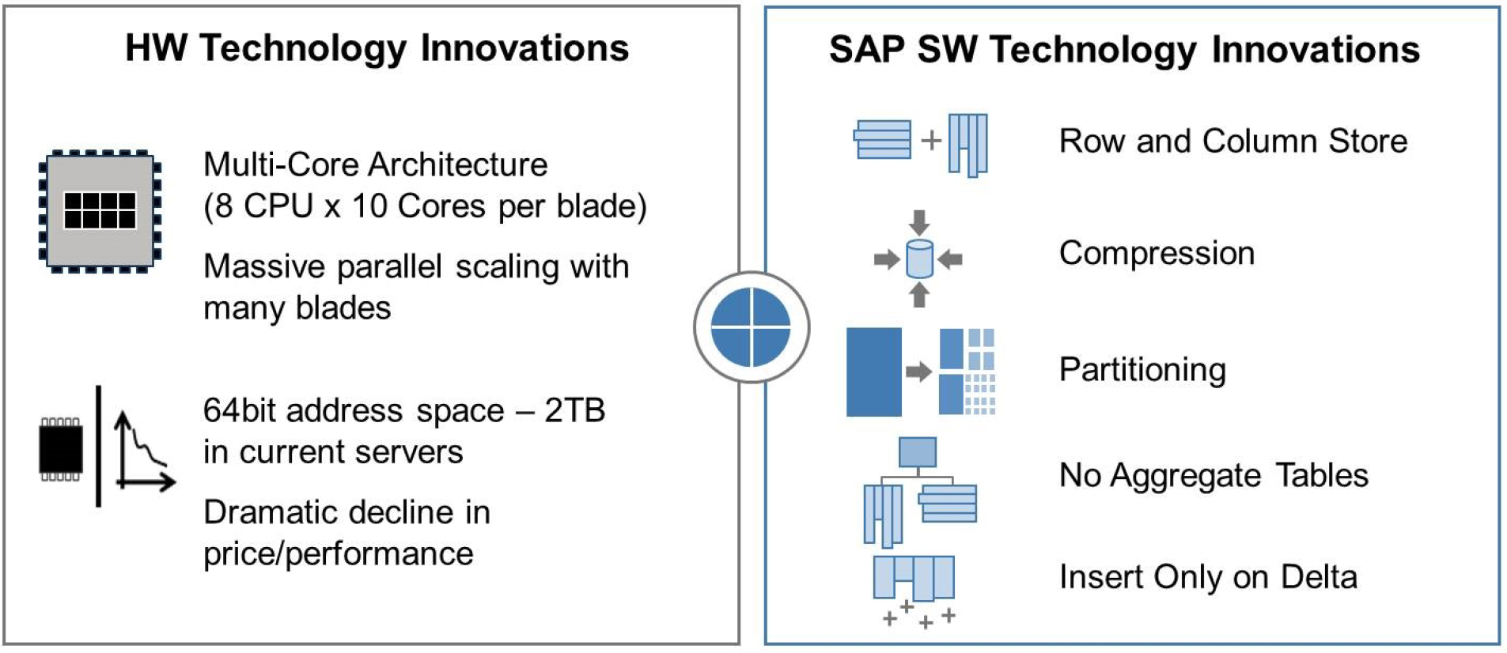
SAP HANA – Technologie
Koncept – in-memory

Slide 6
SAP HANA – Technologie
Koncept – in-memory

Slide 7
SAP HANA – Technologie
Koncept – in-memory (struktura na disku)

Slide 8
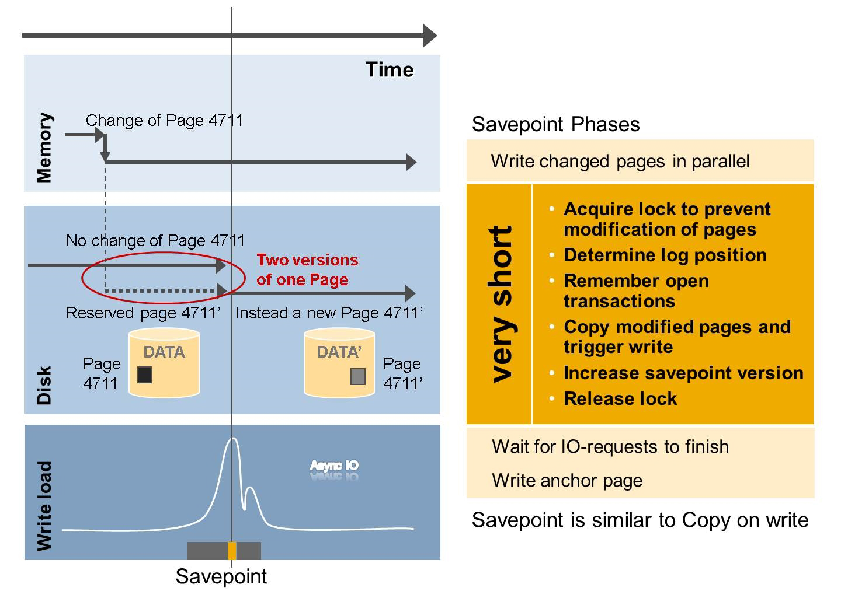
SAP HANA – Technologie
Koncept – in-memory – Savepoint

Slide 9
SAP HANA – Technologie
Koncept – in-memory – HANA database start

Slide 10
SAP HANA – Technologie
Koncept – in-memory – HANA database re-start

Slide 11
SAP HANA – Technologie
Koncept – in-memory – HANA Memory Pool

Slide 12
SAP HANA – Technologie
Koncept – in-memory – HANA Memory Pool

Slide 13
SAP HANA – Technologie
Koncept – in-memory – HANA Store Memory Management

Slide 14
SAP HANA – Technologie
Koncept – in-memory – Delta Merge Process

Slide 15
In-memory koncepty
Architektura systému
Edice
Nasazení

Slide 16
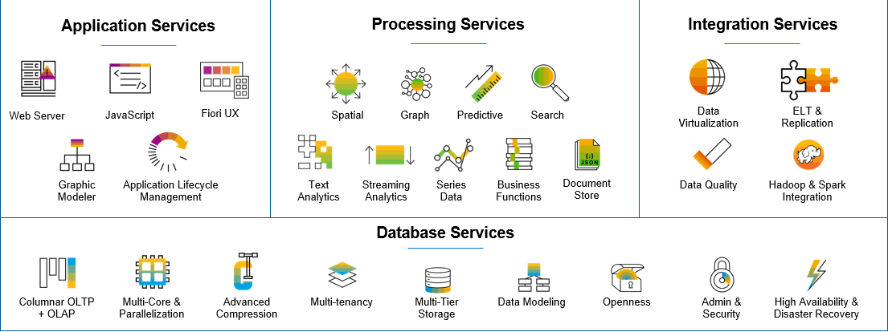
SAP HANA – Technologie
Architektura – rozdělení dle vrstev

Slide 17
SAP HANA – Technologie
Aplikační vrstva – Procesní vrstva – Databázová vrstva – Integrační vrstva
Podpora otevřených standardů (J/ODBC, XML/A)
Web Server podporuje server side JavaScript a Odata
Fiori UX knihovny staví na standardu HTML5
Application LCM = doinstalování součástí/aktualizace

Slide 18
SAP HANA – Technologie
Aplikační vrstva – Procesní vrstva – Databázová vrstva – Integrační vrstva
Doinstalace funkcionalit pomocí AFL

Slide 19
SAP HANA – Technologie
Aplikační vrstva – Procesní vrstva – Databázová vrstva – Integrační vrstva

Slide 20
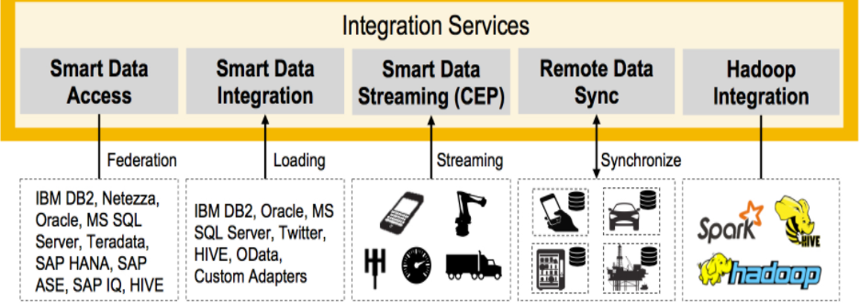
SAP HANA – Technologie
Aplikační vrstva – Procesní vrstva – Databázová vrstva – Integrační vrstva

Slide 21
SAP HANA – Technologie
Charakteristiky platformy
SAP HANA Platform
SAP HANA Studio |  | Clients |  | Information Composer
INA Toolkit |  | SHINE Model Demo |  | EPM Service
SAP HANA Database
SQL, SQLScript, JavaScript, HTML 5, SAP River
HWCCT |  | Application & UI Services (XS) |  | Business Rules
Database Services |  |  | Stored Procedures & Data Models
Text Analysis & Mining | Search |  | Predictive & Planning |  | Geo-Spatial
Smart Data Access | INA File Loader |  | Application Function Library |  | LCApps

Slide 22
SAP HANA – Technologie
Architektura – komponenty

Slide 23
SAP HANA – Technologie
Architektura – Administrační nástroje
SAP HANA Cockpit & Database Explorer
Linux command line tools (HDB)
SAP HANA database interactive terminal (hdbsql)
SAP HANA client suite
SAP HANA Studio
SAP Solution Manager, SAP Landscape Management

Slide 24
SAP HANA – Technologie
Architektura – Administrační nástroje

Slide 25
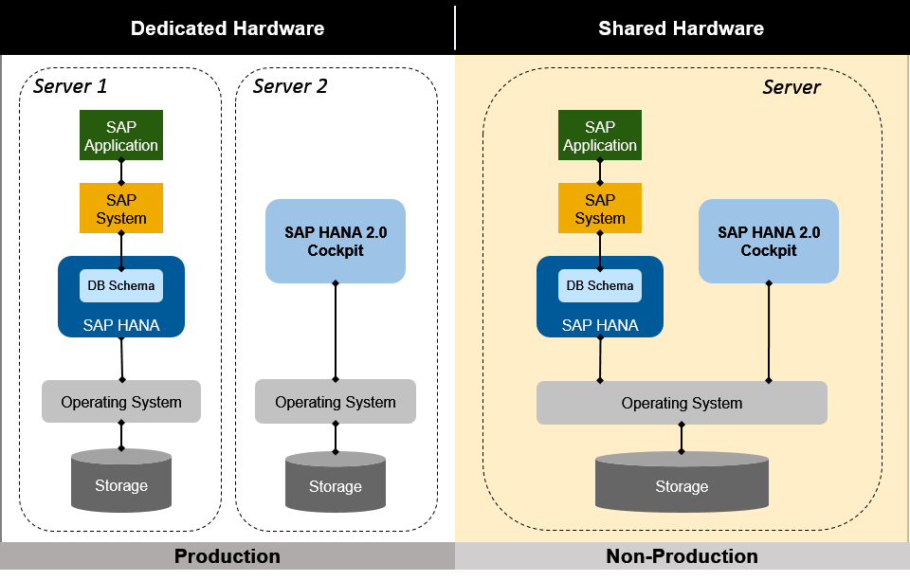
SAP HANA Cockpit & Database Explorer
https://launchpad.support.sap.com/#/notes/2380291

Slide 26
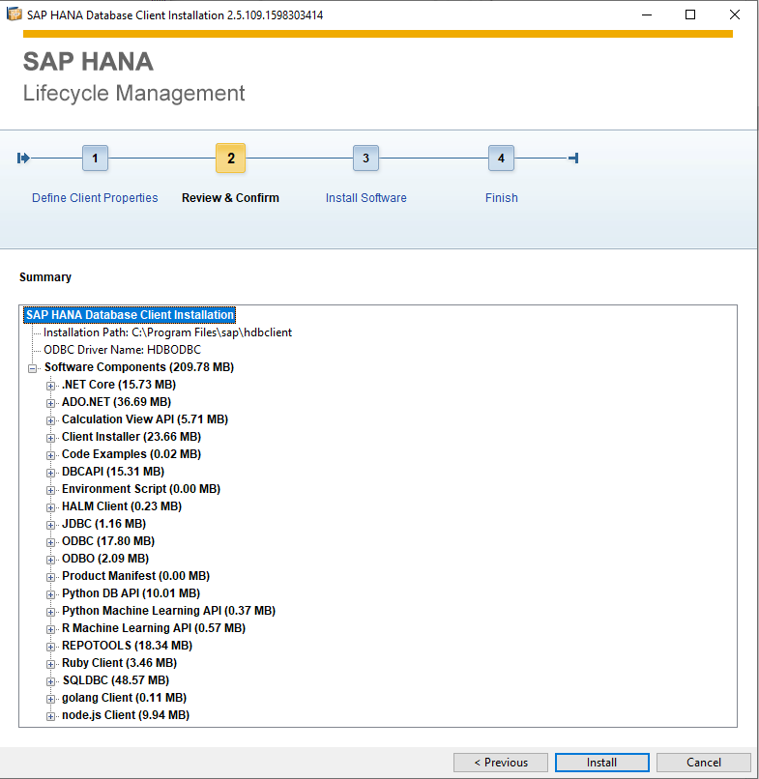
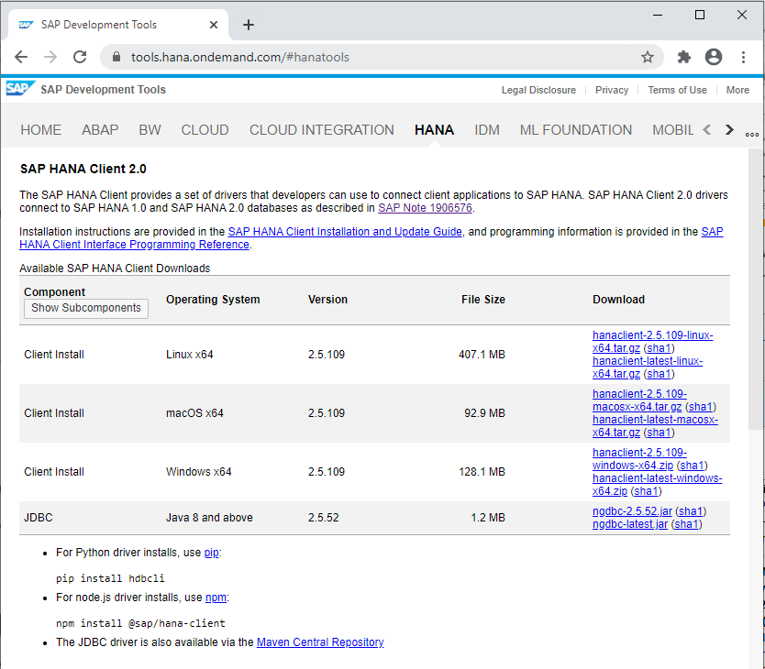
SAP HANA Client 2.0
https://tools.hana.ondemand.com/#hanatools

Slide 27
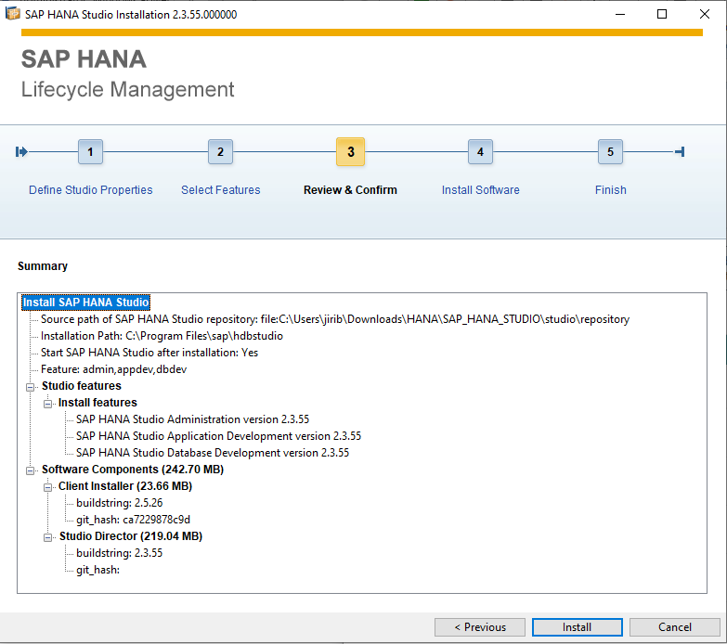
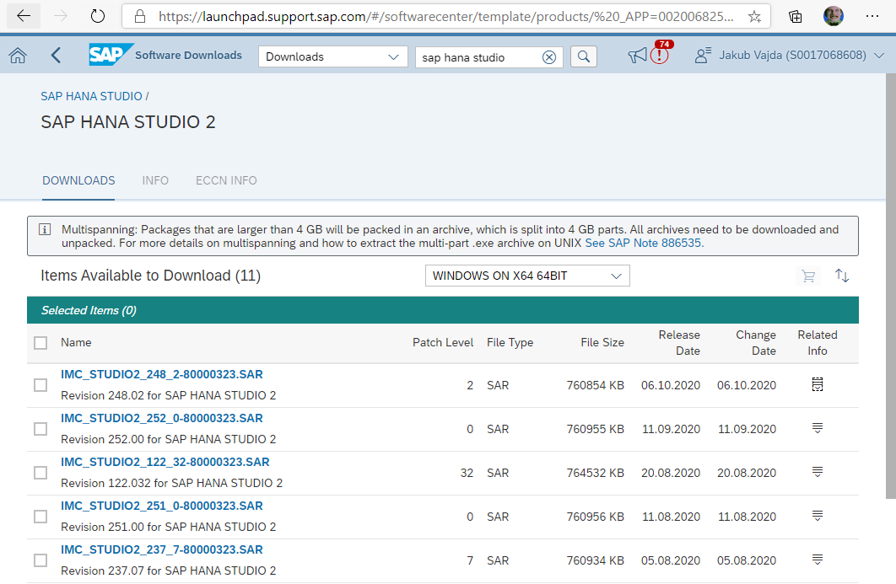
SAP HANA Studio 2.0
https://launchpad.support.sap.com/

Slide 28
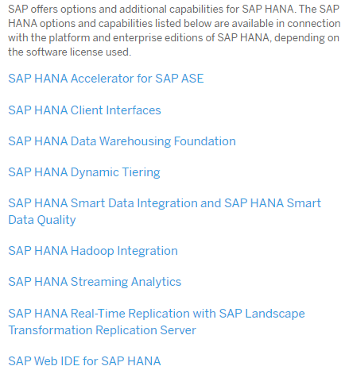
SAP HANA – Technologie
SAP HANA Options & Additional Capabilities

Slide 29
SAP HANA – Technologie
SAP HANA Single/Multiple Container

Slide 30
SAP HANA – Technologie
SAP HANA Main Components

Slide 31
SAP HANA – Technologie
SAP HANA Core processes

Slide 32
SAP HANA – Technologie
SAP HANA Index Server

Slide 33
In-memory koncepty
Architektura systému
Edice
Nasazení

Slide 34




SAP HANA – Technologie
Edice
Runtime edition
Pay a fee to run SAP applications on SAP HANA
Enterprise edition
Purchase the SAP HANA platform
The runtime edition offers a limited platform exclusively for SAP applications, with capabilities restricted to the application layer.
The enterprise edition provides an unrestricted platform for all systems and distributed data in modern hybrid environments.

Slide 35
SAP HANA – Technologie
Edice
Standard edition
Purchase the SAP HANA platform with limited features
Express edition
Out of the box
Includes up to 8x dynamic tiering, add options as needed.
Limited to 32 GB RAM, single instance.

Slide 36



























SAP HANA – Úvod
Software license type
Select SAP HANA software license type:
SAP HANA, runtime edition
SAP applications
SAP HANA, enterprise edition
SAP HANA platform
SAP HANA, runtime edition
The advanced capabilities of the SAP HANA business data platform are only available by and through the licensed SAP application with the only exception being the use of the graphic modeler to build views to be used only for reporting purposes.
Direct data platform connection is limited to SAP or certified 3rd-party business intelligence tools only.
All data extraction must occur via the application layer.
Application development
Advanced analytical processing
Data integration and quality
Web server
JavaScript
Fiori UX
Spatial
Graph
Predictive
Search
Data virtualization
ELT & replication
Graphic modeler
Application lifecycle management
Text analytics
Streaming Analytics
Series Data
Business functions
Document Store
Data quality
Hadoop & Spark integration
Database management
SAP HANA, runtime edition, can only be used by applications from SAP.
Columnar OLTP + OLAP
Multi-core & Parallelization
Advanced Compression
Multi-tenancy
Multi-tier storage
Data modeling
Openness
Admin & security
High availability & disaster recovery

Slide 37
SAP HANA – Úvod
Software license type
Select SAP HANA software license type:
SAP HANA, runtime edition
SAP applications
Custom applications
3rd Party applications
SAP HANA, enterprise edition
SAP HANA platform
SAP HANA, enterprise edition
The advanced capabilities of the SAP HANA business data platform are available for use either via an application layer (SAP, 3rd Party, or Custom) or directly via the data platform.
Direct data platform connection is available via open standards by any tool.
Data extraction may be performed either via an application layer or directly from SAP HANA platform.
Application development
Advanced analytical processing
Data integration and quality
Web server
JavaScript
Fiori UX
Spatial
Graph
Predictive
Search
Data virtualization
ELT & replication
Graphic modeler
Application lifecycle management
Text analytics
Streaming Analytics
Series Data
Business functions
Document Store
Data quality
Hadoop & Spark integration
Database management
SAP HANA, enterprise edition, can be used for any application (SAP, 3rd Party, or Custom)
Columnar OLTP + OLAP
Multi-core & Parallelization
Advanced Compression
Multi-tenancy
Multi-tier storage
Data modeling
Openness
Admin & security
High availability & disaster recovery

Slide 38
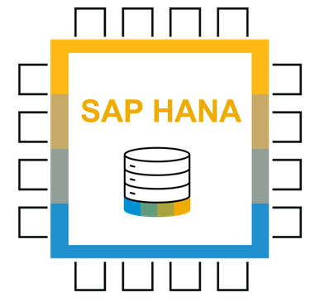
SAP HANA – Úvod
SQL Data Access
Runtime edition
SAP applications
SAP and 3rd-party applications and tools
Data extraction only at the application layer
Connection methods primarily based on proprietary protocol (remote function call [RFC]) and language (ABAP)
Typically requires SAP-specific skillset
SAP HANA, runtime edition
Enterprise edition
SAP applications
SAP and 3rd-party applications and tools
Data extraction at application layer or database layer
Connection methods based on standard protocols (ODBC, JDBC, ODBO, and OData) and languages (SQL and MDX)
Industry-standard skillset not unique to SAP
SAP HANA, enterprise edition

Slide 39

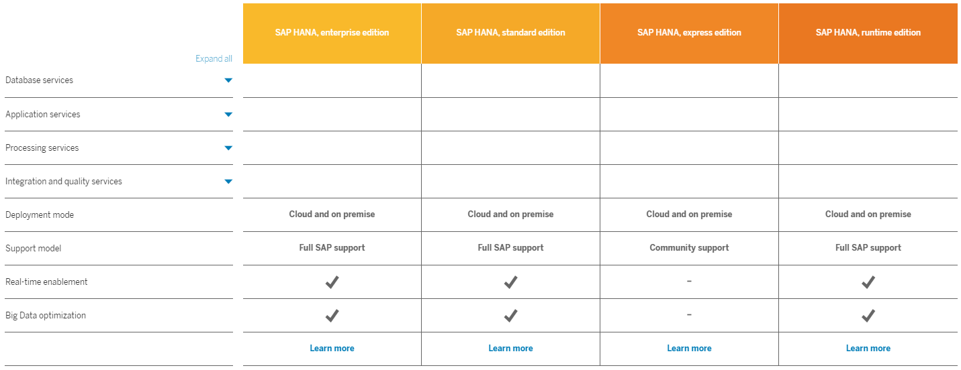
SAP HANA – Úvod
Srovnání edicí - https://www.sap.com/products/hana/pricing.html

Slide 40
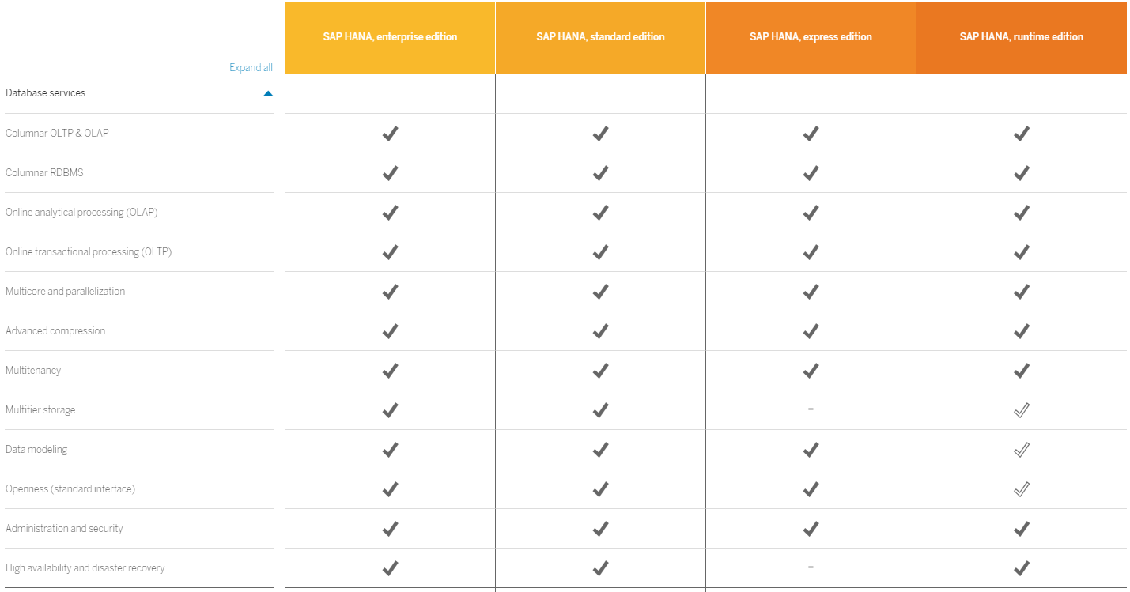


SAP HANA – Úvod
Srovnání edicí - https://www.sap.com/products/hana/pricing.html

Slide 41
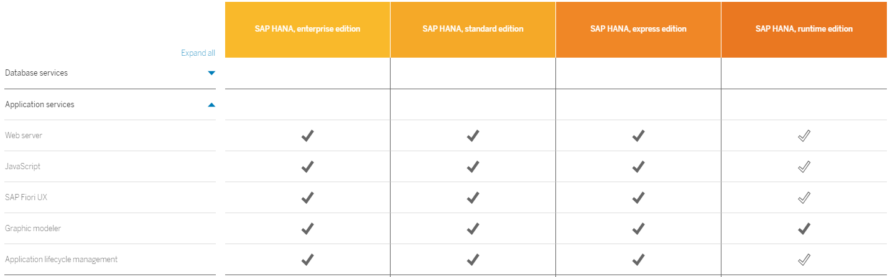
SAP HANA – Úvod
Srovnání edicí - https://www.sap.com/products/hana/pricing.html

Slide 42
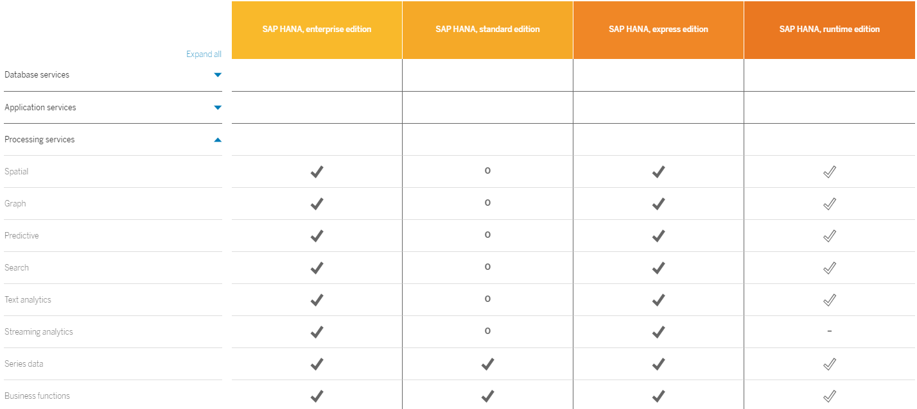
SAP HANA – Úvod
Srovnání edicí - https://www.sap.com/products/hana/pricing.html

Slide 43
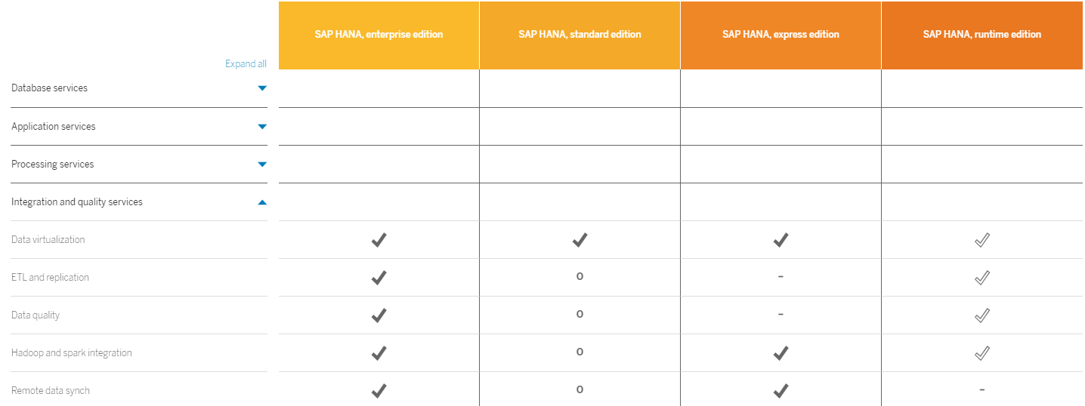
SAP HANA – Úvod
Srovnání edicí - https://www.sap.com/products/hana/pricing.html

Slide 44
SAP HANA – Úvod
Srovnání edicí - https://www.sap.com/products/hana/pricing.html

Slide 45
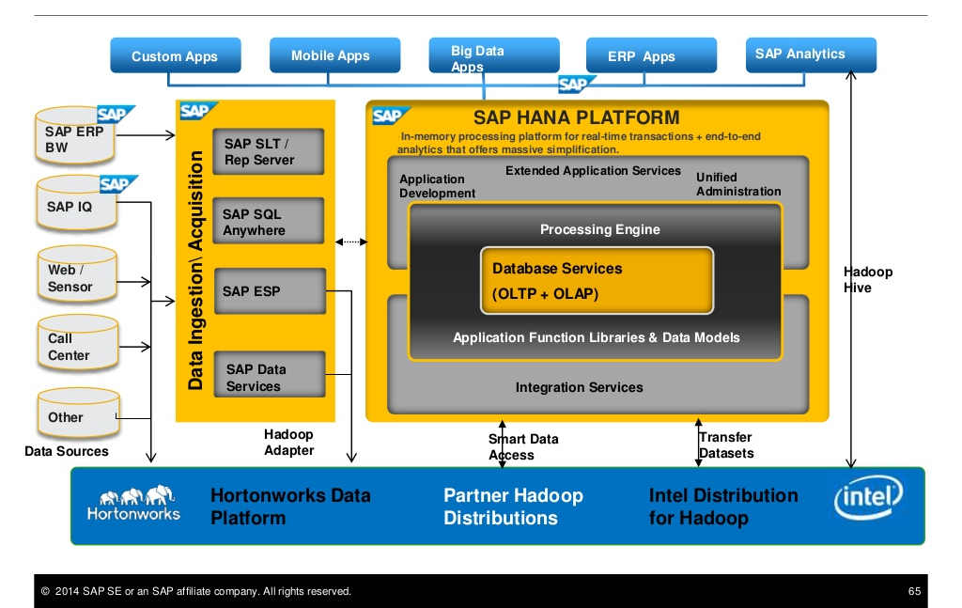
SAP HANA – Technologie
SAP HANA Platforma a Hadoop

Slide 46
In-memory koncepty
Architektura systému
Edice
Nasazení

Slide 47
SAP HANA – Úvod
Nasazení

Slide 48
SAP HANA – Úvod
Nasazení – On-Premise

Slide 49
SAP HANA – Úvod
Nasazení – Cloud Platform

Slide 50
Deployment model
On Premise
Cloud
Appliance
TDI
Public (IaaS)
Private (Enterprise in the Cloud)
Sizing
Technical Deployment
SAP HANA – Úvod
Nasazení - typy

Slide 51
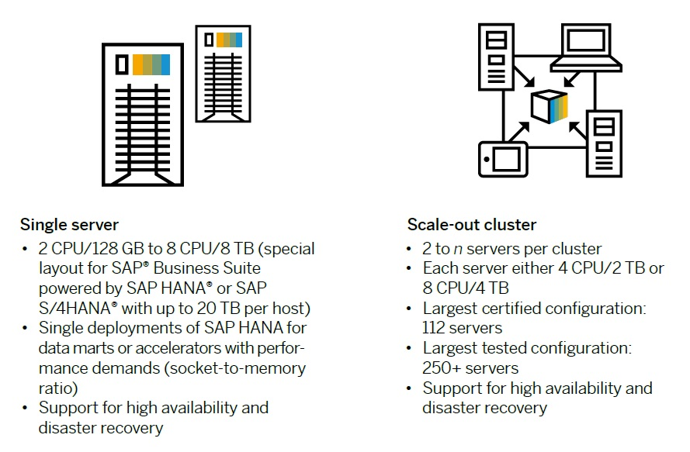
SAP HANA – Úvod
Škálovatelnost

Slide 52
SAP HANA – Úvod
Škálovatelnost

Slide 53
SAP HANA – Úvod
Nasazení - licensování

Slide 54
SAP HANA – Úvod
Nasazení – strategie aktualizací

Slide 55
SAP HANA – Úvod
Nasazení – strategie aktualizací

Slide 56
SAP HANA – Úvod
Nasazení – capture & replay

Slide 57

Děkuji za pozornost
Jakub Vajda
konzultant
Jakub.vajda@mdsaptech.com
linkedin.com/company/mdsap
@MDSapTech
slideshare.net/MDSapTech
www.mdsaptech.com

